Slide 1
DV1C04 Deployt & Monitoring in DevOps
L05
Automation in Deploy Phase

Slide 2
Learning Objectives
Implement automation in Deploy Phase
Describe and Integrate Deploy Phase to DevOps pipeline

Slide 3
Variables in Puppet
Variables are used to store values so that they can be accessed later in code.
You cannot change the value of a variable once it's been allocated.
Variables are affected by the order in which they are evaluated.
A variable must be assigned a value before it can be resolved.

Slide 4
Variables in Puppet
Variable names must begin with a dollar symbol ($) and are case-sensitive.
A lowercase letter or an underscore must be used to begin most variable names.
Regex capture variables, on the other hand, are named solely with integers.

Slide 5
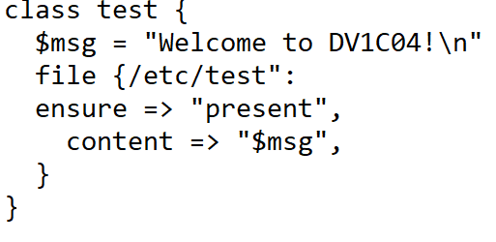
Variables in Puppet
Variable in Class

Slide 6
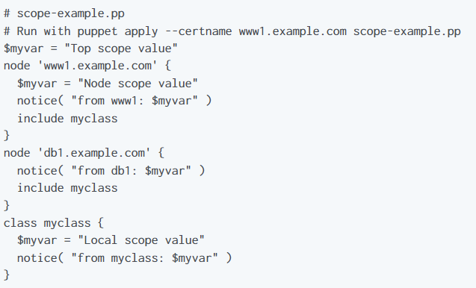
Variables in Puppet
Puppet allows a given variable to be assigned a value only one time within a given scope.
Source: https://puppet.com/docs/puppet/6/lang_variables.html

Slide 7
Facts
Puppet uses the Facter tool to acquire system information, termed facts, before requesting a catalog for a managed node or generating one with puppet apply.
Facts are allocated to variables that can be used anywhere in your manifests as values.

Slide 8
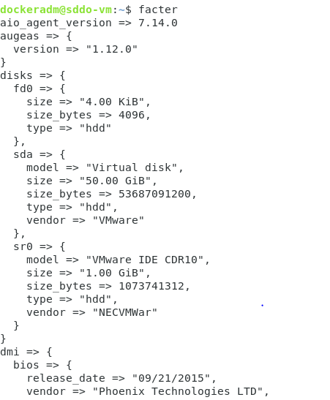
Facts
When creating a catalog, puppet code has access to the following information: Core Facts from Facter.
JSON-Format

Slide 9
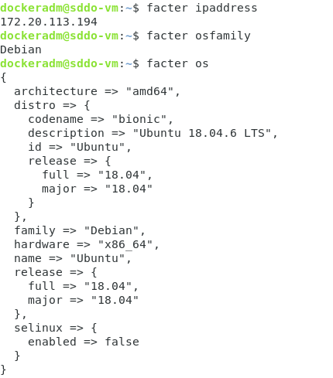

Facts
Using Dot Notation
JSON-Format

Slide 10
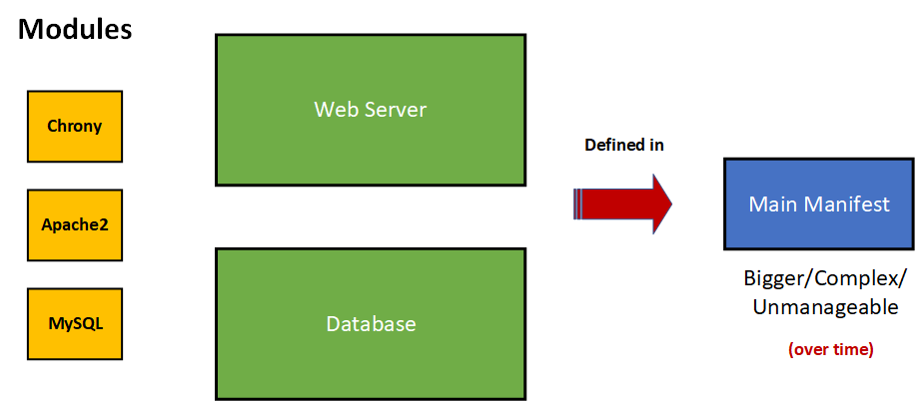

Puppet Roles and Profiles
Main Manifest gets bigger, complex and unmanaged over time when modules are assigned directly in it rapidly over time.
Not good design model!

Slide 11
Puppet Roles and Profiles
Component modules — Normal modules that manage one particular technology, for example puppetlabs/apache.
Profiles — Wrapper classes that use multiple component modules to configure a layered technology stack.
Roles — Wrapper classes that use multiple profiles to build a complete system configuration.
Source: https://puppet.com/docs/pe/2019.8/osp/the_roles_and_profiles_method.html

Slide 12
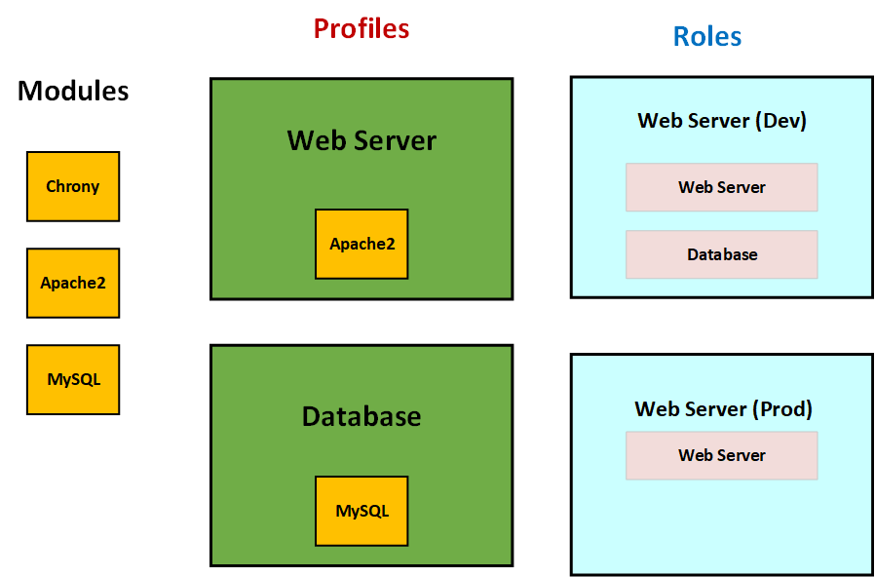
Puppet Roles and Profiles

Slide 13
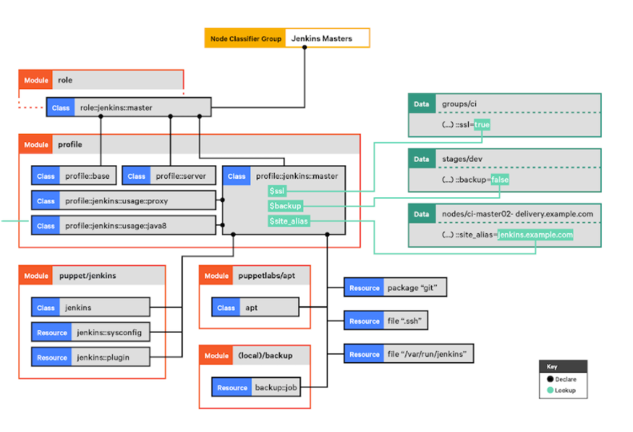
Puppet Roles and Profiles
Source: https://puppet.com/docs/pe/2019.8/osp/the_roles_and_profiles_method.html

Slide 14
Hiera
Hiera is a built-in key-value configuration data lookup system for keeping data separate from Puppet code.
The reusable code is Puppet's strength.
Site-specific information should be stored in external configuration data files rather than in the code itself, because code that serves several purposes must be flexible.

Slide 15
Hiera
Hiera is used by Puppet to accomplish two goals:
Key-value pairs should be used to store configuration data.
During catalog compilation, check what data a specific module requires for a given node.

Slide 16
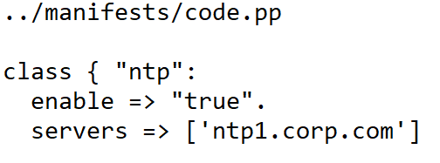
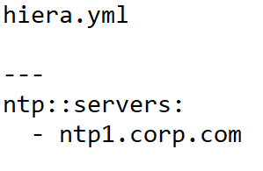
Hiera
Example: If the following puppet code is to shared to someone, one may needs to change the server data before the code can be reused.
Hiera allows the move of such data to a separate file for storing the data.
DATA

Slide 17
Managing code with Code Manager
Code Manager makes it easy to manage and deploy your Puppet code.
Code Manager syncs your code to your primary server and compilers when you push code updates to your source control repository.
This enables all of your servers to run the new code as soon as feasible, without interfering with existing agent runs.

Slide 18
Managing code with Code Manager
Code Manager leverages r10k and the file sync service to automatically manage your environments and modules by staging, committing, and syncing your code.
Code Manager can be triggered in three ways to begin a code deployment:
When you submit code to the control repo, a webhook from your Git server starts the code deployment automatically.
A deploy request is sent to Git by Continuous Delivery for Puppet Enterprise.
To manually trigger Git from the command line, you utilize puppet-code.

Slide 19
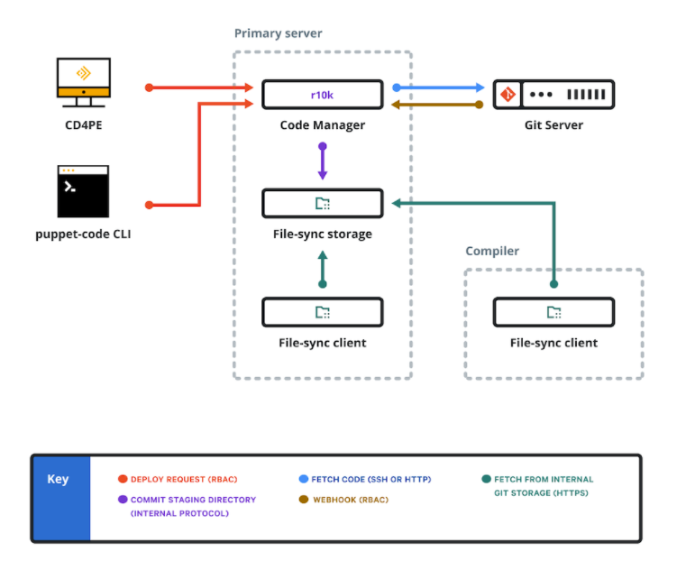
Managing code with Code Manager

Slide 20
MCollective
MCollective distributes commands to systems in parallel using a push method instead of the pull method that is used by Puppet.
MCollective installation is more complicated than Puppet’s.
Before we can use it, we need to set up a Stomp messaging server and configure the MCollective server on each of our hosts.

Slide 21
MCollective
MCollective distributes commands to systems in parallel using a push method instead of the pull method that is used by Puppet.
MCollective installation is more complicated than Puppet’s.
Before we can use it, we need to set up a Stomp messaging server and configure the MCollective server on each of our hosts.

Slide 22
MCollective
The MCollective "server" is the component that needs to be installed on each of your nodes.
The client is a command console that communicates with the server.

Slide 23
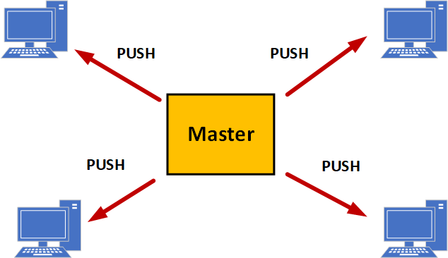
MCollective

Slide 24
Continuous delivery with Jenkins and Puppet Enterprise
In continuous delivery pipelines, Jenkins Pipeline plugin for Puppet Enterprise uses Puppet to handle any or all of the deployment responsibilities.
The Puppet Enterprise plugin for Jenkins Pipeline solves the problem by offering simple methods for setting Hiera settings, deploying Puppet code to Puppet masters, and managing Puppet orchestration jobs that can be triggered from a Jenkinsfile.
To cross the everything-as-code divide, the plugin makes it simple for pipeline code to handle infrastructure code.

Slide 25
Continuous delivery with Jenkins and Puppet Enterprise
The Puppet Enterprise for Jenkins Pipeline plugin has no system requirements, making Jenkins management team buy-in easier.
All you have to do now is download the plugin from the update center.
To execute its job, the plugin makes use of Puppet Enterprise APIs.

Slide 26
Continuous delivery with Jenkins and Puppet Enterprise
The plugin's configuration is quite simple.
It's a three-step process:
Set the Puppet server's address.
Using a Pupppet Enterprise RBAC authentication token, create a Jenkins credential.
Set up the Hiera backend.

Slide 27
References
https://puppet.com/docs/puppet/6/lang_variables.html
https://puppet.com/docs/puppet/7/hiera_intro.html#hiera_intro
https://puppet.com/docs/pe/2019.8/code_mgr_how_it_works.html#how_code_manager_works
https://puppet.com/blog/how-to-continuous-delivery-jenkins-puppet-enterprise/
https://www.jenkins.io/blog/2016/12/20/jenkins-puppet-enterprise-plugin/
Puppet for Absolute Beginners - Hands-on By Mumshad Mannambeth, Yogesh Raheja
Managing Infrastructure with Puppet By James Loope

Slide 28
Thank you

